Slide 1
Cascade (Dual-Loop) Voltage-Current Control of a Buck Converter
Hitesh V S 25BEE1165
Vijay Varshan P 25BEE1148
Adithya K S 25BEE1101

Slide 2
Contents
Introduction
Literature Review
GAP Analysis
Block Diagram
Objectives
Work done (Simulation)
Reference

Slide 3
Introduction
Why specifically this one
Buck Converter
Voltage and Current Control

Slide 4
Literature Review
Paper | Work done | Outcome
A current control method for bidirectional multiphase DC-DC boost-buck converter | To minimize the ripple current entering into the battery and also make the voltage flow bidirectional | With the help of a virtual resistor, transient oscillation is damped
Boundary-Based PWM Control Scheme for a DC-DC Buck Converter Operating in CCM | Operating a Buck convertor in continuous conduction mode | Faster and accurate regulation of voltage and also it is robust for variations in parameters
Cascaded Voltage and Current Control for a Dual Active Bridge Converter with Current Filters | Used Single phase shift modulation to reduce ripple current | Due to the use of SPS modulation, it provides settling time for half switching cycle
A Cascaded Synchronous Buck Converter for Light Electric Vehicle Charging Applications | synchronous buck converter is cascaded with a series capacitor synchronous buck converter, provides a high current gain | 93.3% charging efficiency was observed

Slide 5
Design and Analysis of Feedback Control for DC-DC Buck Converter | K-Factor method controller is designed | The output voltage is stable compared to a normal buck convertor and also reaches steady state faster
Two Independent Single-Loop Voltage Mode Control Method for 3-Level Buck Converter | Used Single loop voltage mode control method | Reduced the output inductor current ripple compared to normal buck converters
Simplified cascade multiphase DC-DC buck power converter for low voltage large current applications: part II --- output current controller | Impressed current method (single phase AC to direct current) | Robustness of current controller under various disturbances are verified
Robust Voltage Control of a Buck DC-DC Converter: A Sliding Mode Approach | Sliding mode control approach , nonlinear control algorithm is adopted | Fast dynamic response and robust characteristics
Dual-Loop Voltage–Current Control of a Fractional-Order Buck-Boost Converter Using a Fractional-Order PIλ Controller | Optimize the controller performance of the system | Better performance of the system after optimization
Control of a DC-DC Buck Converter through Contraction Techniques | Design asymptotically globally stable controller for switched systems | Controller is globally stable

Slide 6
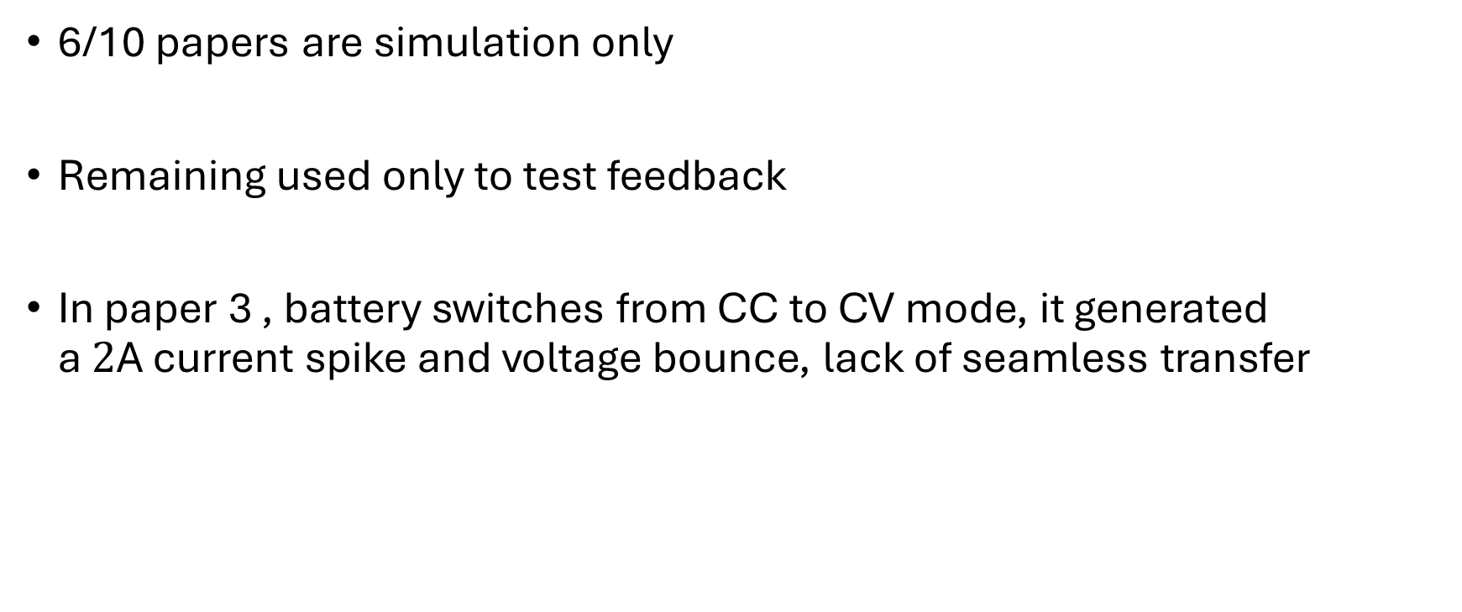
GAP Analysis
6/10 papers are simulation only
Remaining used only to test feedback
In paper 3 , battery switches from CC to CV mode, it generated a $2\text{A}$ current spike and voltage bounce, lack of seamless transfer

Slide 7
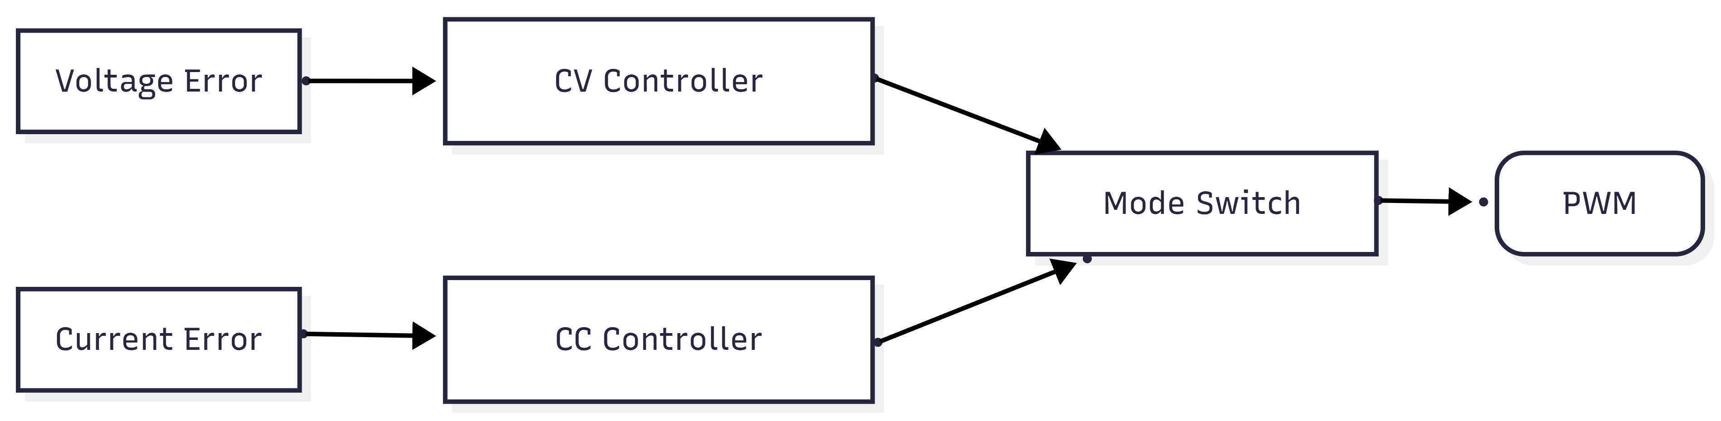
Block Diagram
1) Detection of fluctuation:

Slide 8
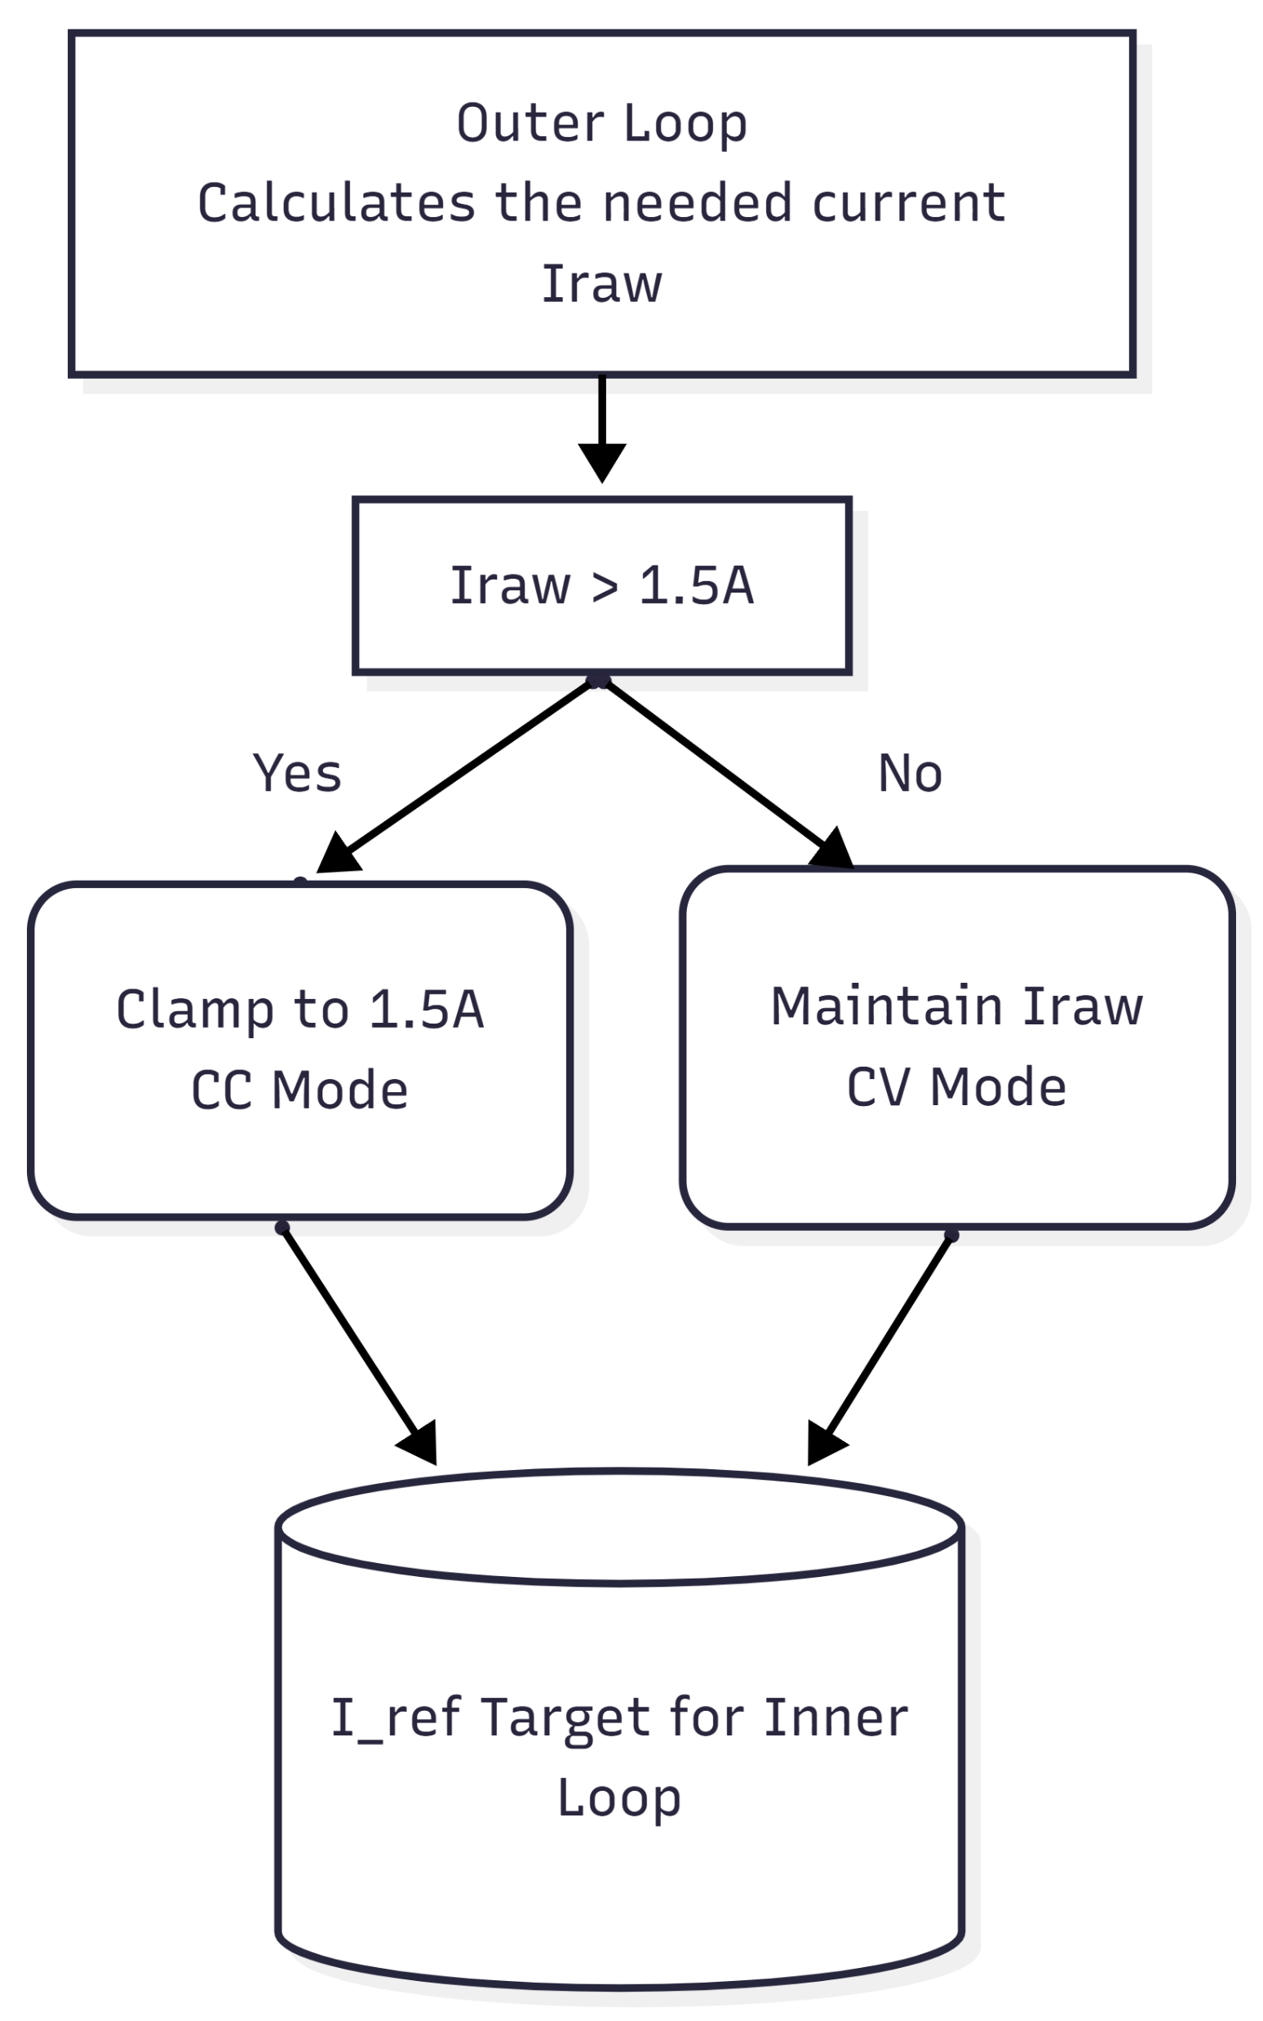
2) Softening Logic:

Slide 9
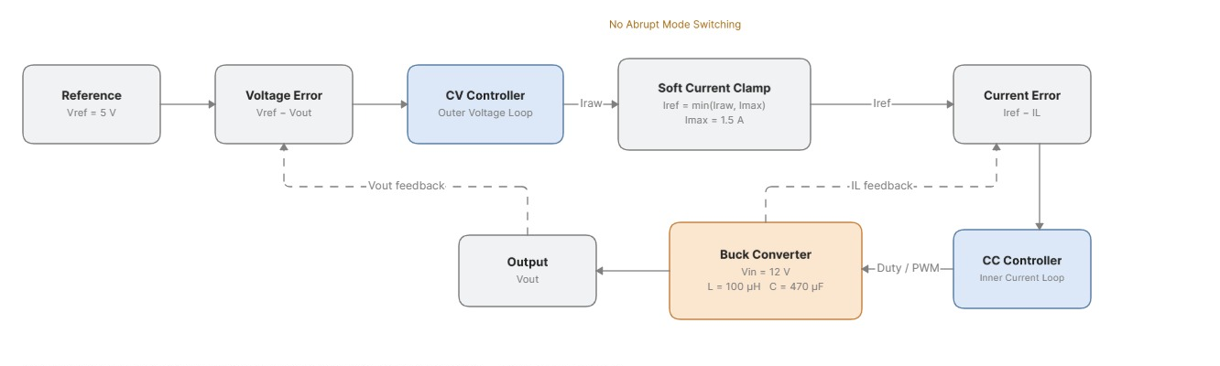
3) Dual Loop Buck Convertor Block Diagram:

Slide 10
Objectives
To smooth out the current spike and voltage bounce from CC to CV

Slide 11
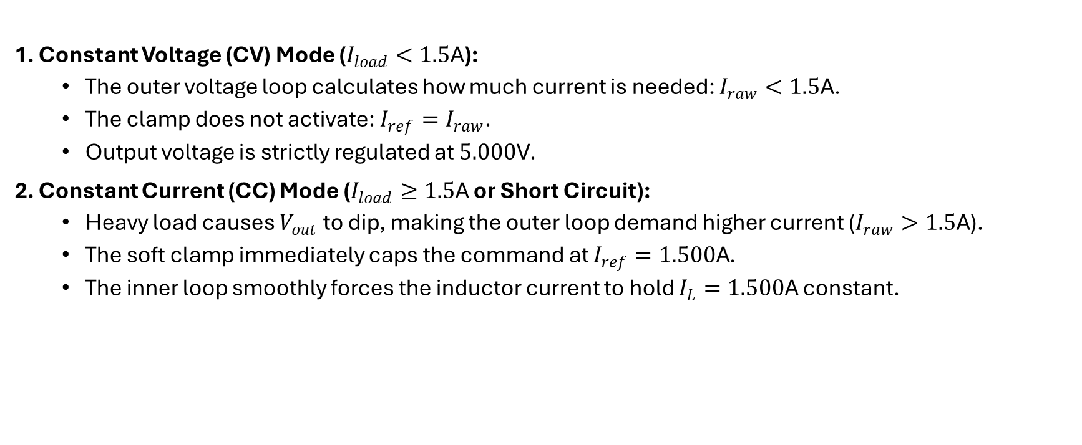
Work Done
Constant Voltage (CV) Mode ($I_{load}<1.5\text{A}$):
The outer voltage loop calculates how much current is needed: $I_{raw}<1.5\text{A}$.
The clamp does not activate: $I_{ref}=I_{raw}$.
Output voltage is strictly regulated at $5.000\text{V}$.
Constant Current (CC) Mode ($I_{load}≥1.5\text{A}$ or Short Circuit):
Heavy load causes $V_{out}$ to dip, making the outer loop demand higher current ($I_{raw}>1.5\text{A}$).
The soft clamp immediately caps the command at $I_{ref}=1.500\text{A}$.
The inner loop smoothly forces the inductor current to hold $I_{L}=1.500\text{A}$ constant.

Slide 12
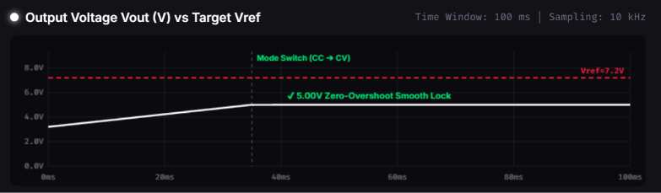
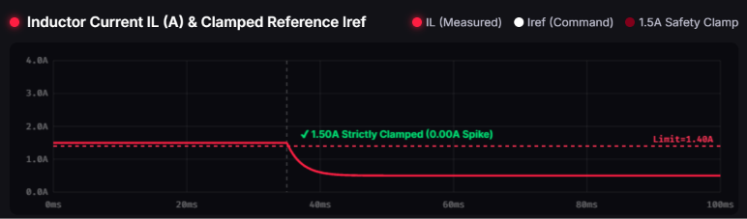
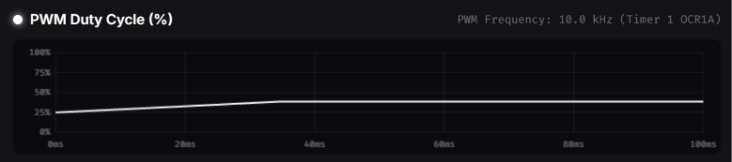

Slide 13
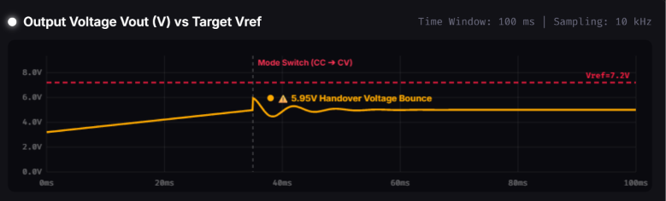
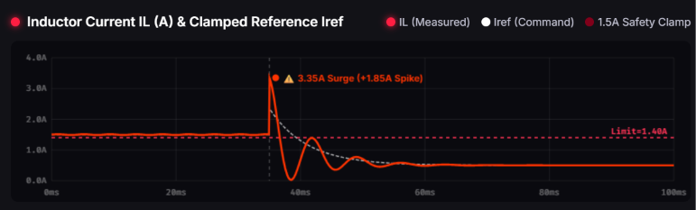
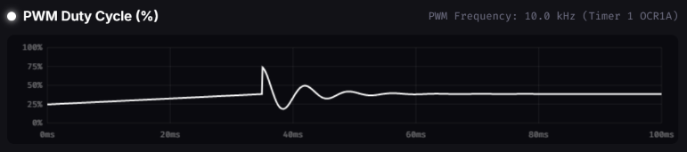

Slide 14
Reference
[1] N. Prameswari, A. B. Ganesen, F. K. Nuraziz, J. Furqani, A. Rizqiawan, and P. A. Dahono, "Simplified cascade multiphase DC-DC buck power converter for low voltage large current applications: part II --- output current controller," Int. J. Power Electron. Drive Syst. (IJPEDS), vol. 12, no. 4, pp. 2273–2283, Dec. 2021, doi: 10.11591/ijpeds.v12.i4.pp2273-2283.
[2] G. I. Hasyim, S. Wijanarko, J. Furqani, A. Rizqiawan, and P. A. Dahono, "A current control method for bidirectional multiphase DC-DC boost-buck converter," Int. J. Electr. Comput. Eng. (IJECE), vol. 12, no. 3, pp. 2363–2377, Jun. 2022, doi: 10.11591/ijece.v12i3.pp2363-2377.
[3] M. F. Akhtar, S. R. S. Raihan, N. A. Rahim, and M. K. Rahmat, "A Cascaded Synchronous Buck Converter for Light Electric Vehicle Charging Applications," Int. J. Integr. Eng. (IJIE), vol. 16, no. 7, pp. 72–82, 2024, doi: 10.30880/ijie.2024.16.07.008.
[4] S. A. Tali, F. Ahmad, and I. H. Wani, "Design and Analysis of Feedback Control for DC-DC Buck Converter," in New Frontiers in Communication and Intelligent Systems, R. Srivastava and A. K. S. Pundir, Eds. India: Computing & Intelligent Systems, SCRS, 2021, pp. 319–328, doi: 10.52458/978-81-95502-00-4-33.
[5] H. Patel and A. Shah, "Boundary-Based PWM Control Scheme for a DC-DC Buck Converter Operating in CCM," Trans. Energy Syst. Eng. Appl. (TESEA), vol. 4, no. 1, Art. no. 504, pp. 1–17, Apr. 2023, doi: 10.32397/tesea.vol4.n1.504.

Slide 15
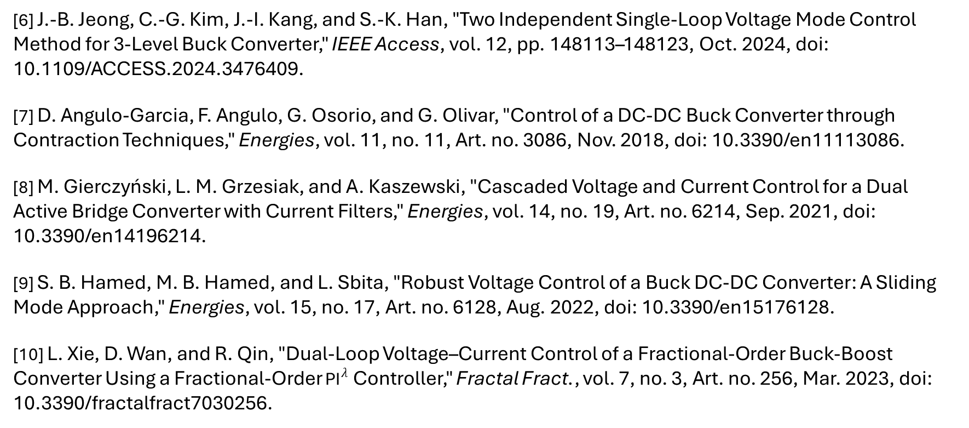
[6] J.-B. Jeong, C.-G. Kim, J.-I. Kang, and S.-K. Han, "Two Independent Single-Loop Voltage Mode Control Method for 3-Level Buck Converter," IEEE Access, vol. 12, pp. 148113–148123, Oct. 2024, doi: 10.1109/ACCESS.2024.3476409.
[7] D. Angulo-Garcia, F. Angulo, G. Osorio, and G. Olivar, "Control of a DC-DC Buck Converter through Contraction Techniques," Energies, vol. 11, no. 11, Art. no. 3086, Nov. 2018, doi: 10.3390/en11113086.
[8] M. Gierczyński, L. M. Grzesiak, and A. Kaszewski, "Cascaded Voltage and Current Control for a Dual Active Bridge Converter with Current Filters," Energies, vol. 14, no. 19, Art. no. 6214, Sep. 2021, doi: 10.3390/en14196214.
[9] S. B. Hamed, M. B. Hamed, and L. Sbita, "Robust Voltage Control of a Buck DC-DC Converter: A Sliding Mode Approach," Energies, vol. 15, no. 17, Art. no. 6128, Aug. 2022, doi: 10.3390/en15176128.
[10] L. Xie, D. Wan, and R. Qin, "Dual-Loop Voltage–Current Control of a Fractional-Order Buck-Boost Converter Using a Fractional-Order ${\text{PI}}^{λ}$ Controller," Fractal Fract., vol. 7, no. 3, Art. no. 256, Mar. 2023, doi: 10.3390/fractalfract7030256.

